Slide 1
ARD
Ali Baqar – alinbaqar@gmaill.com
Anahit Sarao - anahitsarao@gmail.com
Maxwell Cheshier - maxcheshier@gmail.com
Brian Josefowicz - brian.josefowicz@sjsu.edu
Notes:
Everyone

Slide 2
Design Architecture
The current design is built up from the CrazyFlie controller
A larger chassis and additional ESC will be added to allow for larger payload and greater speeds
Raspberry Pi Zero will be mounted on the drone
It will be responsible for integrating the camera and various sensors to the drone controller
The sensors will be utilized for object detection and avoidance
Notes:
Max

Slide 3
Current Status
CrazyFlie has seen several remote controlled test flights
Current design is too weak to carry the intended payload
ESC and larger chassis ordered in order to address this concern
Various programs are being looked at for stable flight modules
Siren and light circuits have been designed
Hardware models have been completed
Additional components including sensors, lights, and additional drones have been ordered
Notes:
Max

Slide 4
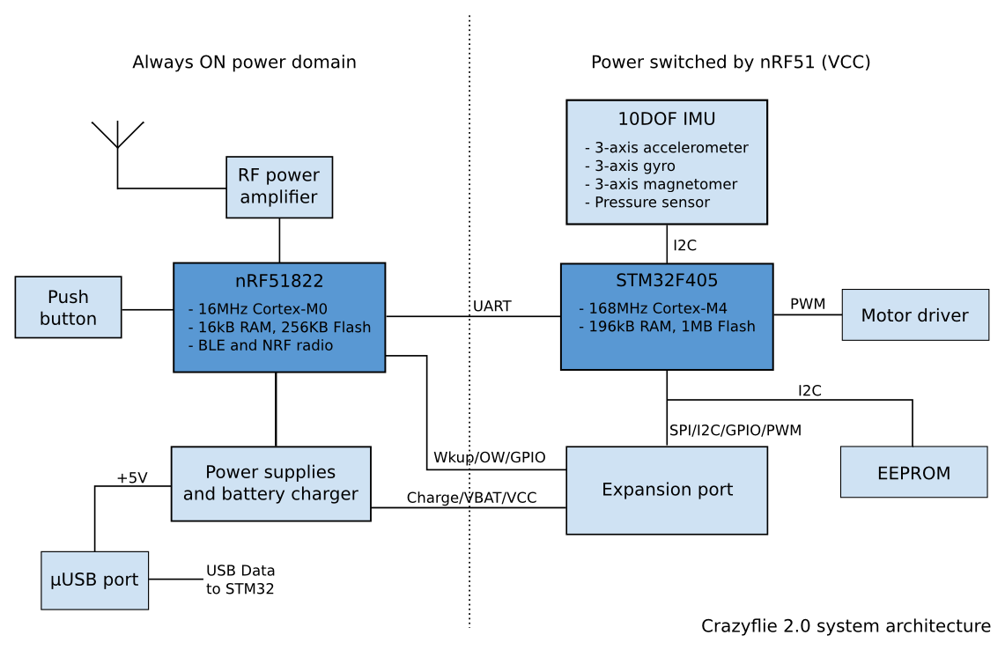
Hardware on the Crazyflie 2.0
A NRF51, Cortex-M0, that handles radio communication and power management
ON/OFF logic
Enabling power to the rest of the system (STM32, sensors and expansion board)
Battery charging management and voltage measurement
Master radio bootloader
Radio and BLE communication
Detect and check installed expansion boards
An STM32F405, 32-bit Cortex® -M4 CPU with FPU @160MHz, that handles the heavy work of flight control and everything else
Sensor reading and motor control
Flight control
Telemetry (including the battery voltage)
Additional user development
CleanFlight?
"Bitcraze Wiki." Projects:crazyflie2:architecture:index [Bitcraze Wiki]. N.p., n.d. Web. 09 Aug. 2017.
Notes:
Ali

Slide 5
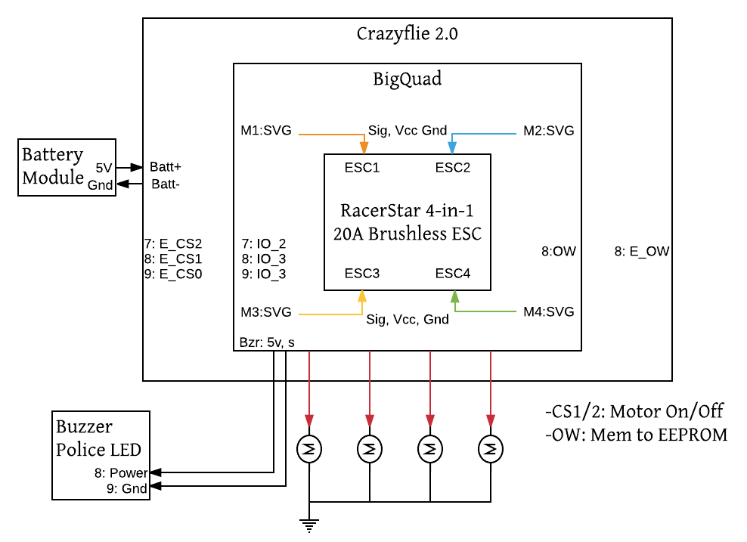
Central Stack
Notes:
Brian

Slide 6
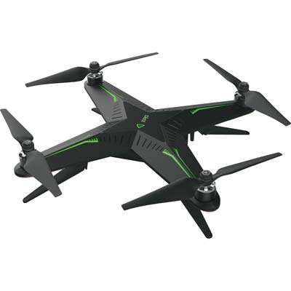
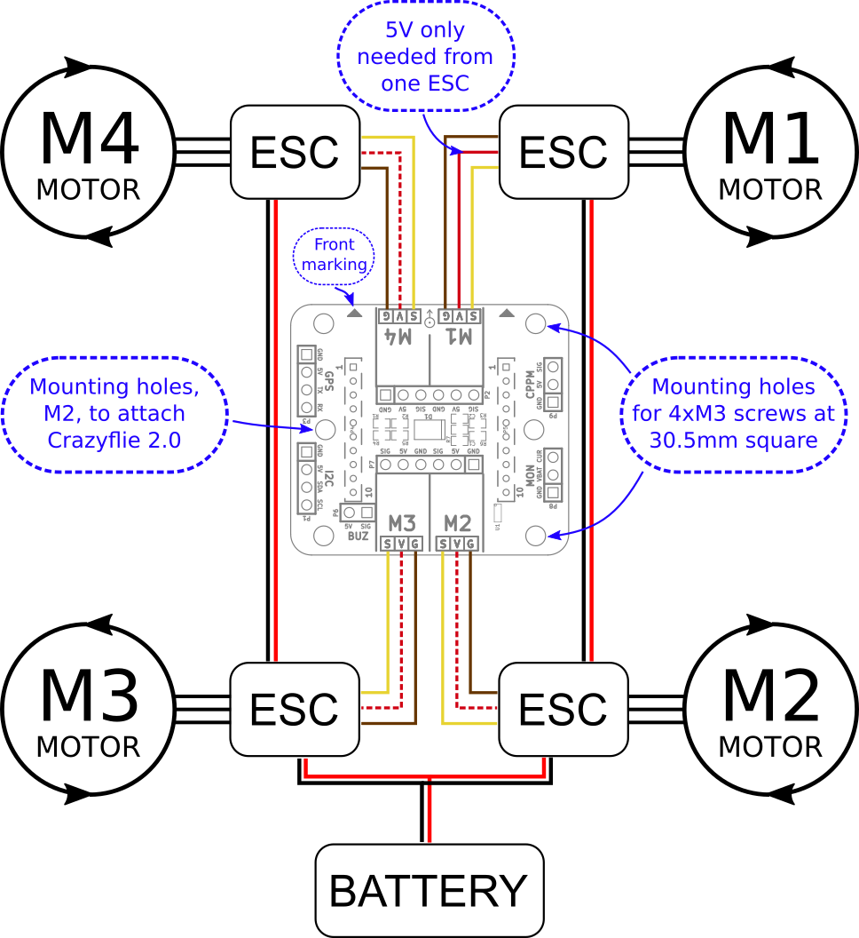
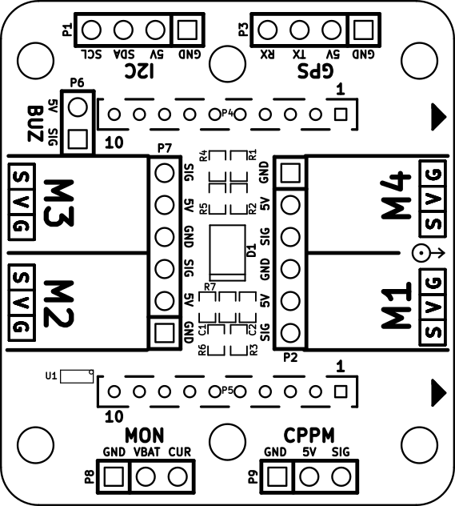
Different Chassis
Larger chassis to support hardware
Removable core will be replaced by Central Stack
RaceStar ESC drives 4 brushless motors
Mounting fixtures are still being designed
Auto Retracting landing gear servos
"Bitcraze Wiki." Projects:crazyflie2:expansionboards:bigquad [Bitcraze Wiki]. N.p., n.d. Web. 09 Aug. 2017.
Notes:
Brian

Slide 7
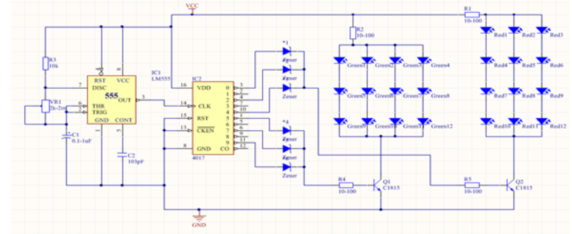
Police Flasher Circuit
4017 IC Decade Counter
555 Timer IC
Blue and Red LED arrays
Notes:
Brian

Slide 8
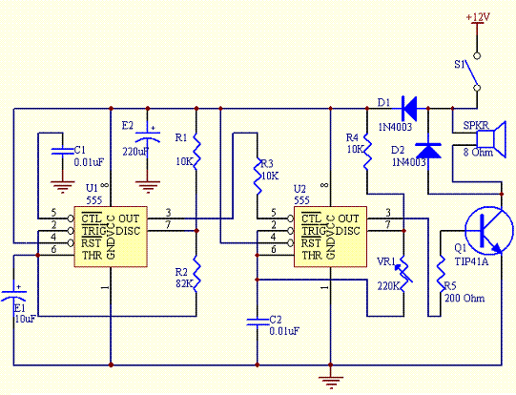
Police Siren Circuit
2 x 555 Timer IC
Speaker
Notes:
Brian

Slide 9
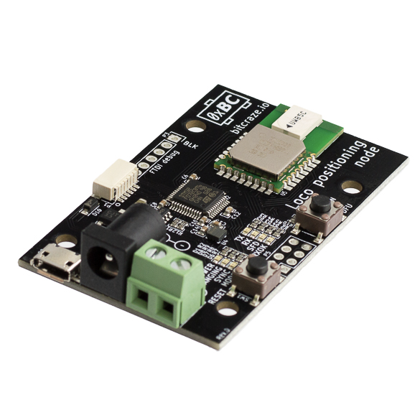
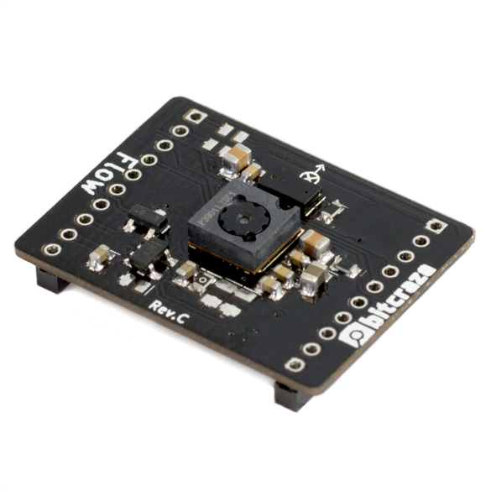
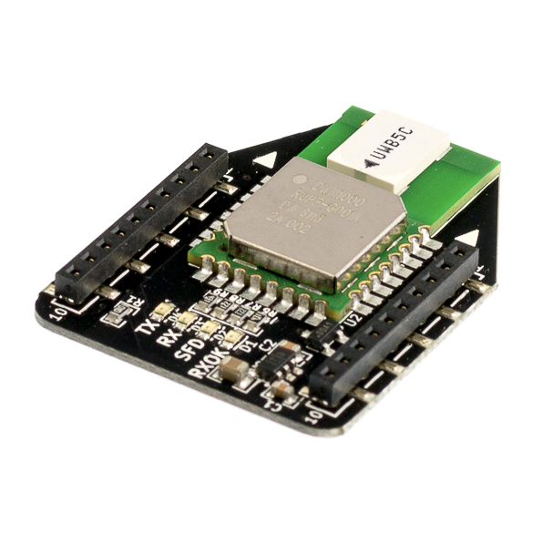
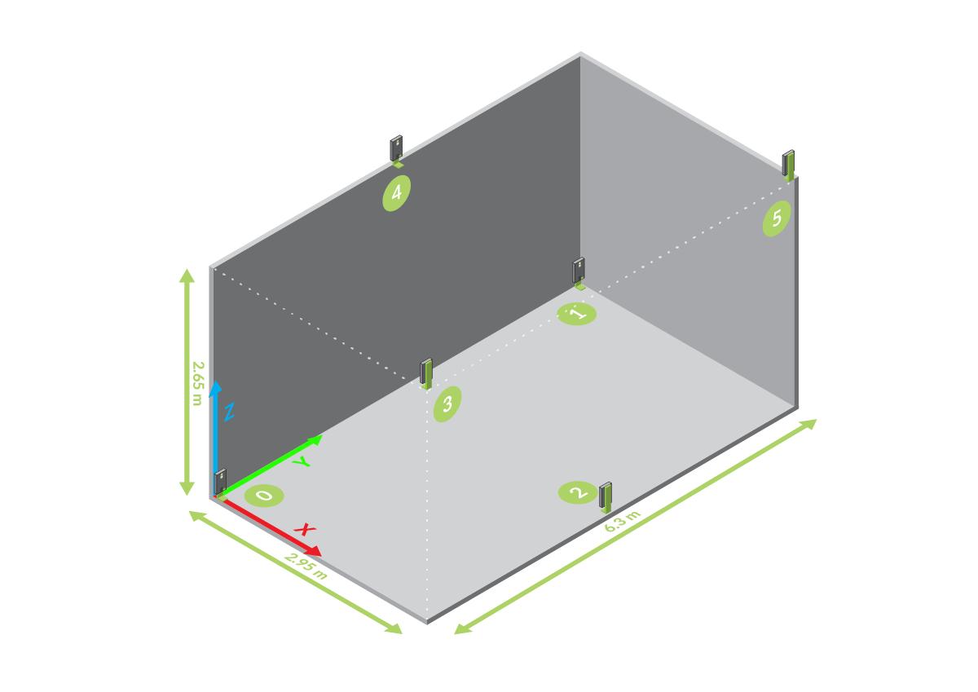
Making the drone Autonomous
Currently the “Loco Positioning” system that can be used by the CrazyFlie 2.0 is using an Optical Flow Sensor
The optical sensor allows us to have the position of the drone in a 3D space
The Loco Positioning Deck is a Tag in a Loco Positioning system and measures the distances to Anchors
The nodes are then placed in the corners of the room and the positioning deck communicates with them
Current Issues
This however is not a practical and realistic way to have it fly autonomously
Ranging accuracy ±10 cm according to DWM1000 spec.
"Getting started with the Loco Positioning system." Bitcraze. N.p., n.d. Web. 09 Aug. 2017.
Notes:
Ali

Slide 10
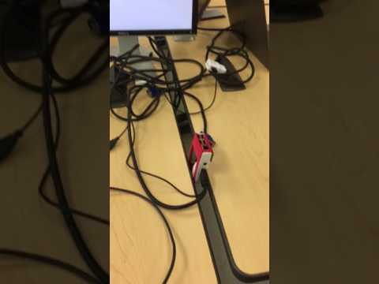
Software on the CrazieFlie 2.0 & RPI
Alpha Software Testing Video
Private Github Repo
https://github.com/s3nu/ARD
The code is cloned from crazyflie main github
https://github.com/bitcraze/crazyflie-firmware
https://github.com/bitcraze/crazyflie-lib-python
https://github.com/bitcraze/toolbelt
Code runs on mac OSX using dependencies:
python3, sdl, sdl2, sdl_image, sdl_mixer, sdl_ttf, libusb, portmidi, pyqt5
Notes:
Anahit

Slide 11
Initial Results
Achieved remote controlled flight
Control achieved through various remotes such as iPhone and PS3 controller
Flight is unstable and will need to be corrected in the future
Raspberry Pi is capable of capturing photo and video
Notes:
Max

Slide 12
Conclusion
Progress has been made however due to some unforeseen problems, we have been slowed
Switch is broken preventing CrazyFlie from entering bootloader mode
Raspberry Pi is working as desired, capturing both photo and video
Components for future expansion have been ordered
Larger chassis and ESC
Controlled flight software is being narrowed down
Notes:
Max

